Slide 1
G PULLIAIAH COLLEGE OF ENGINEERING AND TECHNOLOGY
COIN BASED MOBILE CHARGER
PRSENTED BY
D.LOHITH KUMAR - 18AT1A0223
K.KARTHIK - 19AT5A0222
Y.VIVEKA VARDHAN - 19AT5A0211
P.CHINNA NAGASIVUDU - 18AT1A0230
UNDER THE GUIDANCE OF
M.VENKATESWARULU

Slide 2
INTRODUCTION
This is the smart coin based mobile charging system that charges your mobile for particular amount of time on inserting a coin. The system is to be used by shop owners, public places like railway stations to provide mobile charging facility. So the system consists of a coin recognition module that recognizes valid coin is found it signals the microcontroller for further action. if a valid coin is found it signals the microcontroller and microcontroller then starts the mobile charging mechanism providing a 5v supply through a power supply through a power supply section to the mobile phone, now systems also needs to monitor the amount of charging to be provided .So the system can be used for smart mobile charging at public places.

Slide 3
The objective of this project is inserting the coin using charge for your mobile phone in public places. This project is very useful to people who are all using mobile phone without charging condition in public places. In this project, who are all using mobile phones in outside of home are office without charging condition. The coin based mobile phone charger is very useful to that person for using coin to charge for that mobile.

Slide 4
The major action in this system is controlled by transmitter section; this section consists of IR transmitter and IR receiver. Here we need to generate IR frequency continuously. So that by using a small tiny microcontroller frequency is produced and is connected IR receiver continuously receives the signals from the transmitter. Whenever the light path in between IR transmitter and IR receiver cuts by an obstacle receiver signal gives low to high pulse. By to the IR led to generate IR light rays of 38 KHz frequency. Connecting the receiver output to the micro controller interrupt pin, it gives interrupt to the micro controller immediately the system gives the buzzer and sends the message to the display on LCD display to the micro controller.

Slide 5
COMPONENTS USED
8051 Microcontroller :
The microcontroller memory is divided into Program Memory and Data Memory. Program Memory (ROM) is used for permanent saving program being executed, while Data Memory (RAM) is used for temporarily storing and keeping intermediate results and variables. Depending on the model in use (still referring to the whole 8051 microcontroller family) at most a few Kb of ROM and 128 or 256 bytes of RAM can be used.

Slide 6

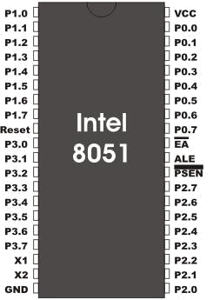
All 8051 microcontrollers have 16-bit addressing bus and can address 64 kb memory.

Slide 7
FEATURES:
8K Bytes of In-System Programmable (ISP) Flash Memory
Endurance: 1000 Write/Erase Cycles
4.0V to 5.5V Operating Range
256 x 8-bit Internal RAM
32 Programmable I/O Lines
Full Duplex UART Serial Channel
Fully Static Operation: 0 Hz to 33 MHz

Slide 8
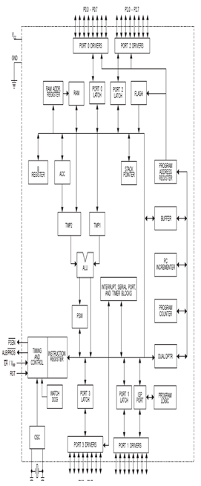

Slide 9
RELAY
A relay is an electrically operated switch. Current flowing through the coil of the relay creates a magnetic field which attracts a lever and changes the switch contacts. The coil current can be on or off so relays have two switch positions and they are double throw (changeover) switches. Relays allow one circuit to switch a second circuit which can be completely separate from the first. For example a low voltage battery circuit can use a relay to switch a 230V AC mains circuit. There is no electrical connection inside the relay between the two circuits; the link is magnetic and mechanical.

Slide 10
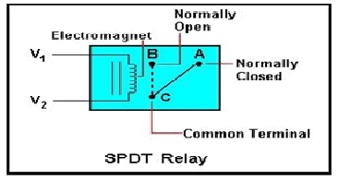

Slide 11
LCD :
LCDs are available to display arbitrary images (as in a general-purpose computer display) or fixed images which can be displayed or hidden, such as preset words, digits, and 7-segment displays as in a digital clock. They use the same basic technology, except that arbitrary images are made up of a large number of small pixels, while other displays have larger elements. LCDs are used in a wide range of applications including computer monitors, televisions, instrument panels, aircraft cockpit displays, and signage. They are common in consumer devices such as video players, gaming devices, clocks watches, calculators, and telephones, and have replaced cathode ray tube (CRT) displays in most applications. They are available in a wider range of screen sizes than CRT and plasma displays, and since they do not use phosphors, they do not suffer image burn-in.

Slide 12
An LCD is made with either a passive matrix or an active matrix display grid. The active matrix LCD is also known as a thin film transistor (TFT) display. The passive matrix LCD has a grid of conductors with pixels located at each intersection in the grid. A current is sent across two conductors on the grid to control the light for any pixel. An active matrix has a transistor located at each pixel intersection, requiring less current to control the luminance of a pixel. For this reason, the current in an active matrix display can be switched on and off more frequently, improving the screen refresh time.

Slide 13
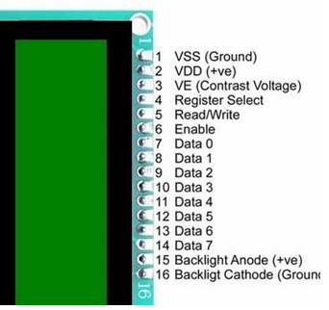

Slide 14
INFRARED TRANSMITTOR AND RECEIVER:
Infrared is an invisible radiation with longer waves than those of visible light. Infrared transmitter is one type of LED which emits infrared rays transmits around 940nm. Similarly IR Receiver is like a LED which is used to receive the IR rays transmitted by the IR transmitter. The One important point is both IR transmitter and receiver should be placed straight line to each other. So only it can sense the IR rays which is transmitted. This IR transmitters and receivers are used in many places like industries for various purpose. In our project,when the coin is let fall between the transmitter and the receiver, the coin cuts the IR radiation for a second. When the IR rays are disturbed, the receiver sends the pulse output to the SCU which is the Signal Conditioning Unit

Slide 15
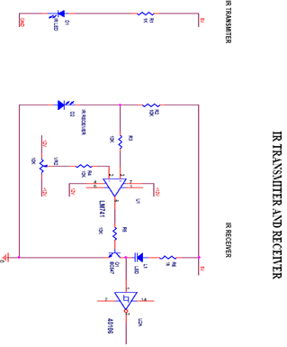

Slide 16
TRANSISTOR:
A transistor is a semiconductor device used to amplify and switch electronic signals and electrical power. It is composed of semiconductor material with at least three terminals for connection to an external circuit. A voltage or current applied to one pair of the transistor's terminals changes the current flowing through another pair of Terminal.Because the controlled (output) power can be higher than the controlling (input) power, a transistor can amplify a signal. Today, some transistors are packaged individually, but many more are found embedded in integrated circuits. The transistor is the fundamental building block of modern electronic devices, and is ubiquitous in modern electronic systems. Following its development in the early 1950s the transistor revolutionized the field of electronics, and paved the way for smaller and cheaper radios, calculators, and computers, etc.

Slide 17
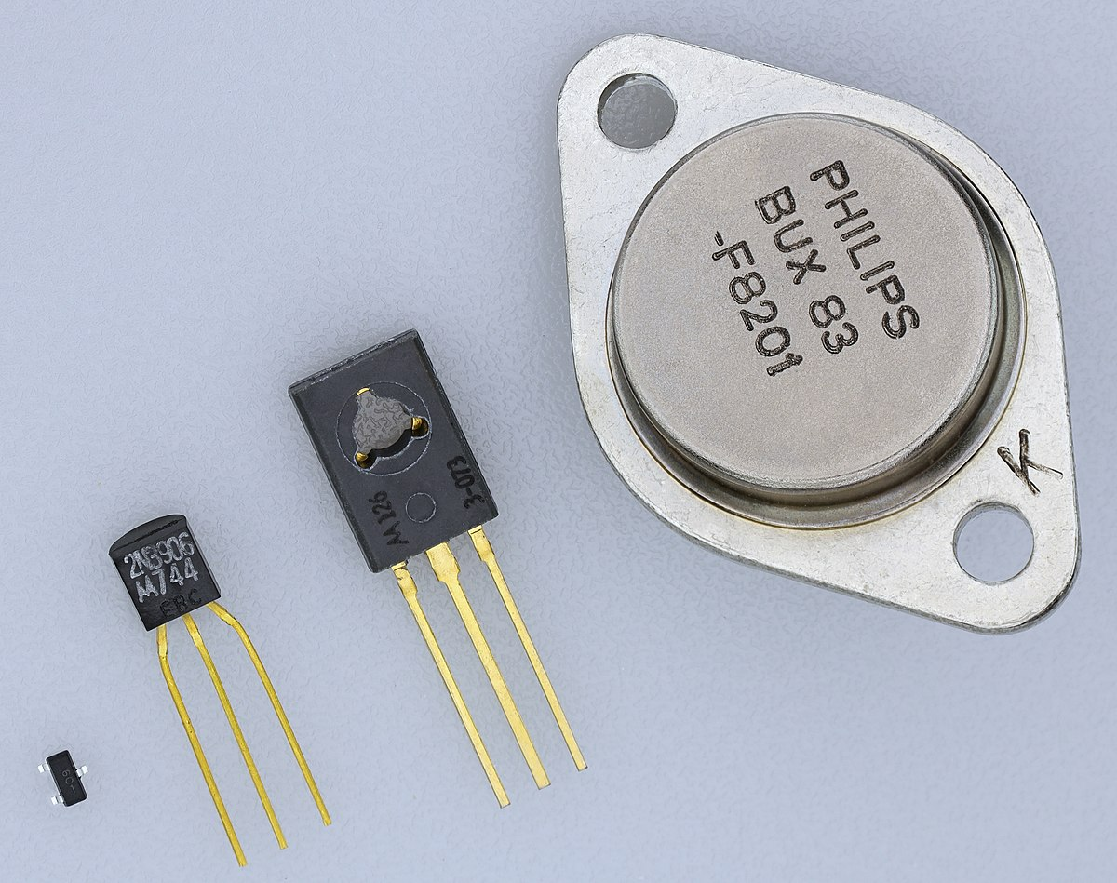

Slide 18
VOLTAGE REGULATOR:
This regulator can provide local on-card regulation, eliminating the distribution problems associated with single point regulation. It employs internal current limiting, thermal shutdown and safe area protection, making it essentially indestructible. If adequate heat sinking is provided, it can deliver over 1A output current. Although designed primarily as fixed voltage regulator, this device can be used with external components to obtain adjustable voltages and currents
Thermal overload protection
Short circuit protection
Output transistion SOA protection
2% output voltage tolerance

Slide 19
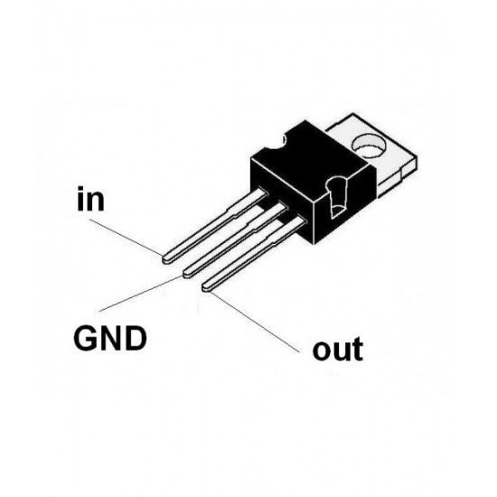
APPLICATIONS:-
To supply a precise amount of voltage.
Power Management

Slide 20
WORKING:
The objective of this project is inserting the coin using charge for your mobile phone in public places. This project is very useful to people who are all using mobile phone without charging condition in public places. In this project, who are all using mobile phones in outside of home are office without charging condition. The coin based mobile phone charger is very useful to that person for using coin to charge for that mobile. A sensor system is used to detect the presence of coin. It may be of different type (IR sensor, Using LDR etc...). The coin is inserted between the transmitted and received signal.

Slide 21
When a signal came from sensor unit, the microcontroller activates the charger unit for a predefined time. After that it will reset to normal case. Driver circuit is used for provide the sufficient input voltage of relay. The relay will on to activate the 230v charger, we will use charger to charge for our mobile phone.
The major action in this system is controlled by transmitter section; this section consists of IR transmitter and IR receiver. Here we need to generate IR frequency continuously. So that by using a small tiny microcontroller frequency is produced and is connected to the IR led to generate IR light rays of 38 KHZ frequency.

Slide 22
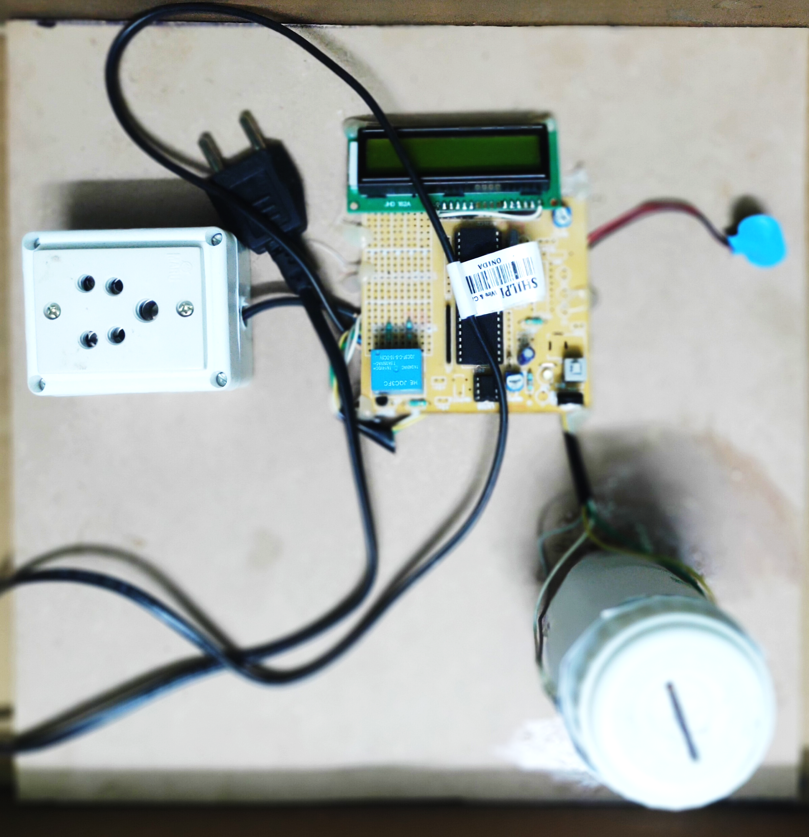

Slide 23
ADVANTAGES
Simple and hand efficient.
Less expensive.
Reduced man power.
Low power consumption.
Installation is easy.
It can be useful while travelling and when we don’t have charger with us during travel.
Simple to operate.

Slide 24
DISADVANTAGES
This project only works when only one coin inserted at one time , incase of multiple coin insertion the project doesn’t activate.
In this project for any type of coin insertion it provides power supply for a constant period of time.
This project does not consists of coin recognition system.

Slide 25
APPLICATIONS
Useful to public for using coin to charge for the mobile phone in any palace.
It can be used for different type of mobiles.
It is used for emergency charging purposes.
It can be installed railway stations, bus stops, villages and rural areas and public places.
It can be installed in office and colleges for pay charging facility.

Slide 26


Slide 27


Slide 28
CONCLUSION
The coin based mobile phone charger is very useful to public for using coin to charge for the mobile phone in any public places just like charging it normally owing to the fact that it relayed the electricity through the coin based mobile charger needed to bring the mobile phone back to life.

Slide 29
THANK YOU

